Slide 1





SPOTIFY
PLAYLIST RECOMMENDER SYSTEM
Data Science course 2024-2025
Created by Manor Shpritz, Ortal Lasry and Or Cohen Raviv.
GITHAB link

Slide 2


Business question?
01
BUSINESS QUESTION?
"How can we develop a system to recommend personalized playlists to users, leveraging playlist data alone to identify contextual relationships between songs and generate relevant suggestions for a given input song?"
Data source here

Slide 3
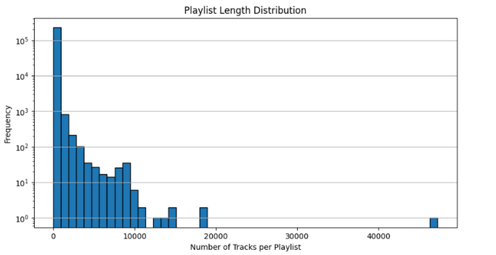
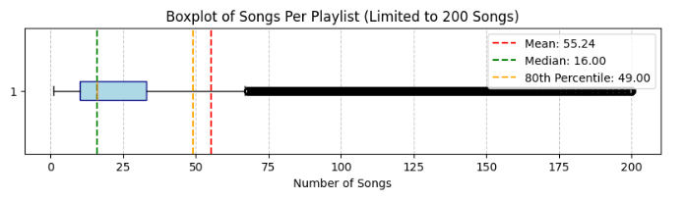
02
About the data
Original data
After data cleaning and preprocessing
EDA
Over 12.7 million rows
Handle missing values and duplicate Rows.
Convert all string columns to lowercase, Standartizing text to ASCII, Removing one-char artists and track names.
Generating 2 new features to handle duplicate track names and playlist names:
songe_name, unq_playlist_name.
user_id: 1,048,575
unique artists: 279,658
unique users: 15,898
track_name: 1854971
playlist_name: 143640
song_name: 2658530
unq_playlist_name: 230708
Removing outliers:
by song_name (<43)
Keeping songs that appear in at least 10 different playlists
include playlists with >10 and < 50 songs
4 features:
user_id is a hash of the user's Spotify user name
artistname is the name of the artist
trackname is the title of the track
playlistname is the name of the playlist that contains this track.

Slide 4
03
Words2vec Model
TOKENS
WORDS2VEC
SIMILARITY MAP
Converts each playlist into a list of song names (tokens) or concatenated string of “artistname:trackname” for Word2Vec training.
each playlist becomes a "sentence," and each “song” becomes a "word" in that sentence.
Learns embeddings for songs and playlists, capturing their contextual relationships
Basic similarity map:
Establishes connections between playlists based on shared songs.
.
Hyper parameters, e.g:
vector_size=100,
window=5,
min_count=1,
sg=1,
workers=4)
Cosine-Based Similarity Map
Each playlist is represented by its average vector, and connections between playlists are based on cosine similarity between these vectors.
How it works:
Word2Vec represents songs as vectors in
a multi-dimensional space (dense vector).
Songs that are closer to each other in this vector space (measured by cosine similarity) are likely to co-occur in playlists and share similar characteristics. Therefore, these songs are recommended together
Evaluation of the Model:
PRECISION=1.00
RECALL=0.69
F1 SCORE: 0.81
(based on train and test data
cold start problem).

Slide 5
04
Siamese network
SIAMESE NETWORK
:מנור תכניס לפה בבקשה את השלבים שעשית במודל
קודם היה טריפלטס
אח״כ לעשות אימבדינג לכל שיר
אח״כ לסדר את האימבדינג שיהיה קריא לרשת נוירונים
אח״כ להחליף את כל השירים בטריפלטס לאימבדינגס שלהם
מודל
מטריקות

Slide 6

05
APPENDIX
APPENDIX

Slide 7
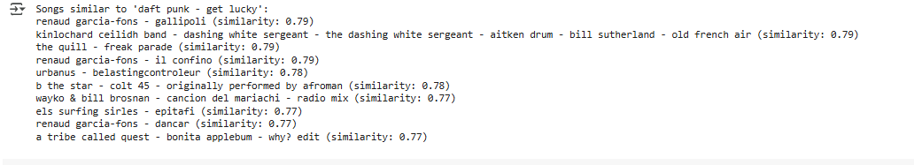
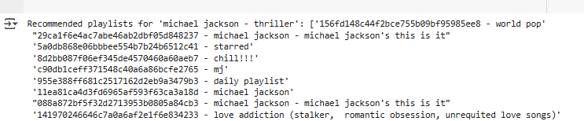
05
APPENDIX
APPENDIX 1
Songs similar to input song:
Recommend Playlists for a Song

Slide 8
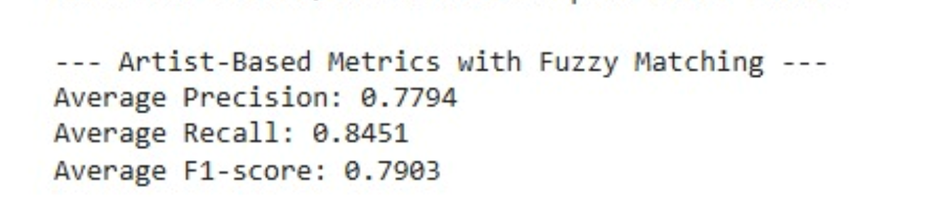
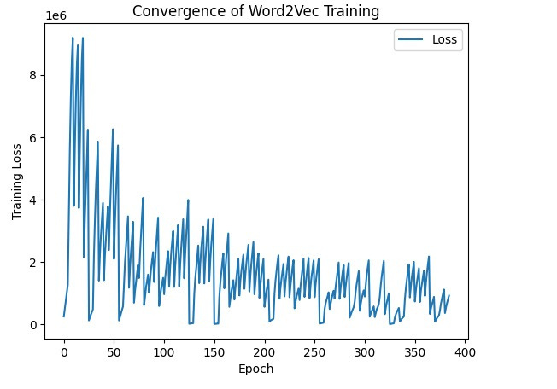
05
APPENDIX
APPENDIX 2
Fuzzy Matching

